Slide 1
Ethical Hacking Project Presentation (Internship Studio)
Present By Akshay Patel

Slide 2
Overview
Introduction
Requirement
ScreenShot

Slide 3
Introduction
Ethical Hacking: To crack passwords or to steal data? No, it is much more than that. Ethical hacking is to scan vulnerabilities and to find potential threats on a computer or networks. An ethical hacker finds the weak points or loopholes in a computer, web applications or network and reports them to the organization

Slide 4
Requirement
NetSparker Software…….
Windows/Linux/any OS…
4GB RAM
2.0 GHz processor
1 GB of HDD space for installation

Slide 5

Step 1 Start Netsparker Software ….

Slide 6
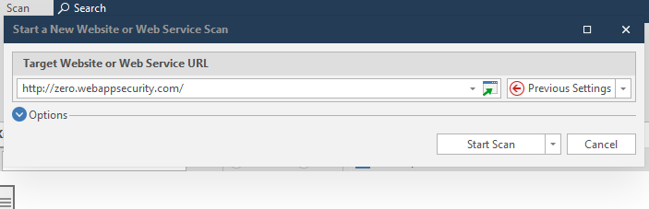
Step 2 Enter Your Target….

Slide 7
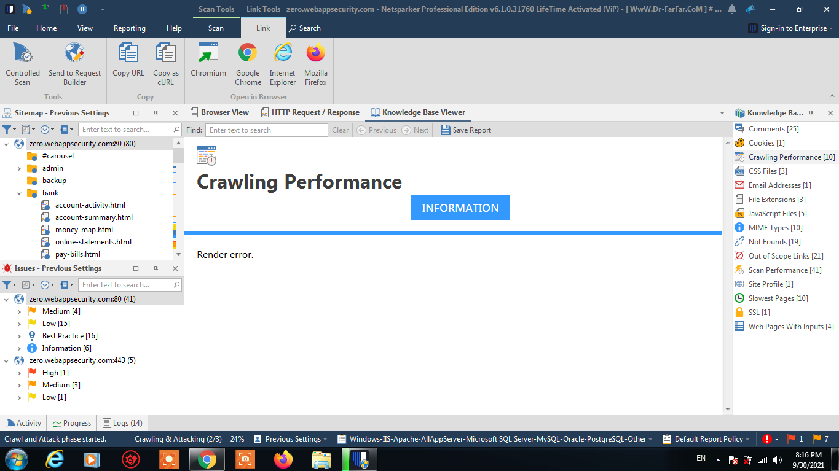
Step 3 Crawling Mode….

Slide 8
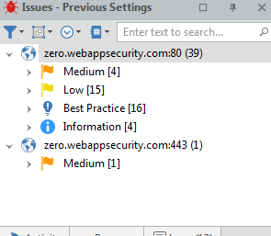
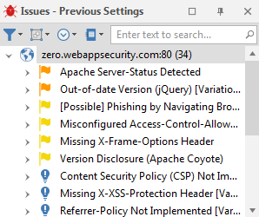
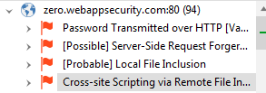
Step 4 Some Screenshot Of Software

Slide 9
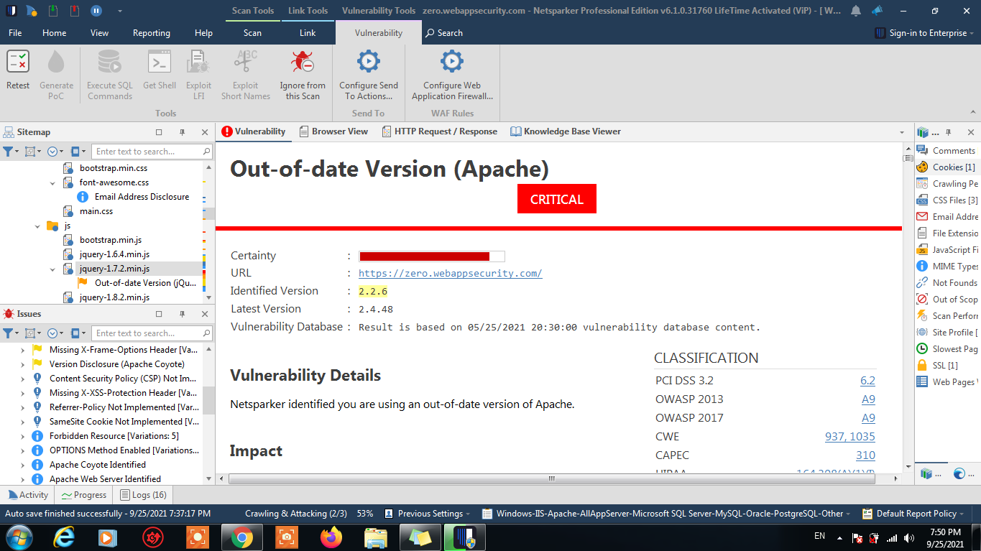
Step 5 Find A Vulnerability Out-Of-Date Version(Apache)

Slide 10

T h a n k Y O U

